Slide 1
INTEGERATED DESIGN PROJECT

Slide 2
GROUP-05
AHM ZOBYER 201714013
FARZANA FARUK JHUMU 201714023
MASRUR HASAN MAHIN 201714027
MD. ARIFUL ISLAM TAREK 201714030
NAFIZ IMTIAZ KHAN 201714043
SUMAIYA NUHA MUSTAHFINA 201714059

Slide 3
PROJECT IDEAS
PUBLIC TRANSPORT SUPPORT AND MANAGEMENT SYSTEM
INTERPRETED SIGN LANGUAGE EXECUTION AND COMMUNICATION WITH THE DISABLED PERSON
DRIVER DROWSINESS DETECTION
SMART SPECTACLE FOR BLIND

Slide 4
MIST AUTOMATED STUDENT ATTENDANCE SYSTEM

Slide 5
AIM
THE VISION OF THE PROJECT IS TO MAKE AN EFFICIENT ATTENDANCE SYSTEM USING FINGERPRINT SENSOR.

Slide 6
MOTIVATION
Behind The Idea
Proxy System
Late Coming
Wasting class time
Proper Idea about ones attendance
Difficulties regarding the application submission

Slide 7
FEASIBILITY
Legal Feasibility
Proper protection of the attendance data
Registered student can give attendance in each class
Ensures the attendance of the present student only

Slide 8
FEASIBILITY
Technical Feasibility
Fingercell technology will be used for matching the fingerprint
Firebase will store the image of fingerprint
Bootstrap will be used for front end design

Slide 9
FEASIBILITY
Economical Feasibility
3 biometric sensor is needed for each class which will cost 20000 taka
Required firebase database space are free
Wi-fi module will cost around 1000 taka
2 LDR Sensors will cost around 30 taka

Slide 10
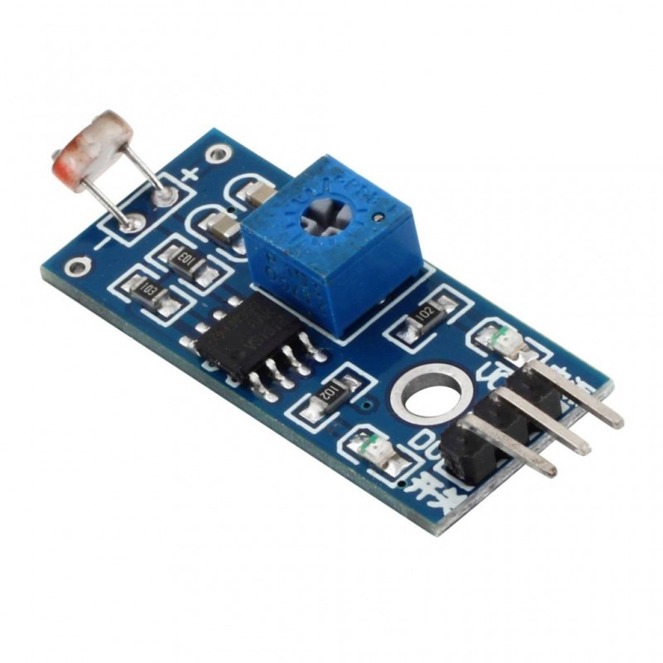
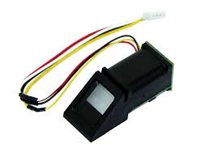
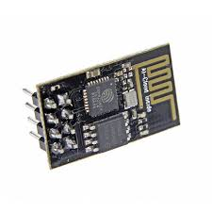
HARDWARES
Fig:fingerprint Scanner
Fig:Wi-fi Module
Fig:LDR Sensor

Slide 11
TEAM LEADER FOR EACH MILESTONE
Idea Proposal & Approval-Ajmir
Project Plan-Abir
SRS First Draft-Mahin
SRS Final-Aurchi
Prototype-Jhumu
Presentation-Nafiz

Slide 12
PROJECT PLANS AND PROGRESS

Slide 13
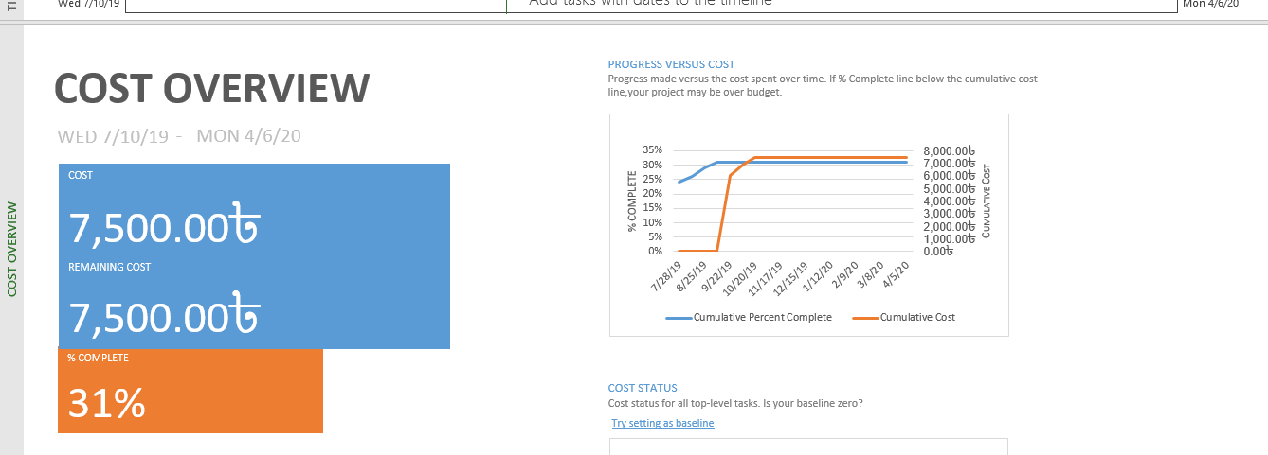
COST ANALYSIS

Slide 14
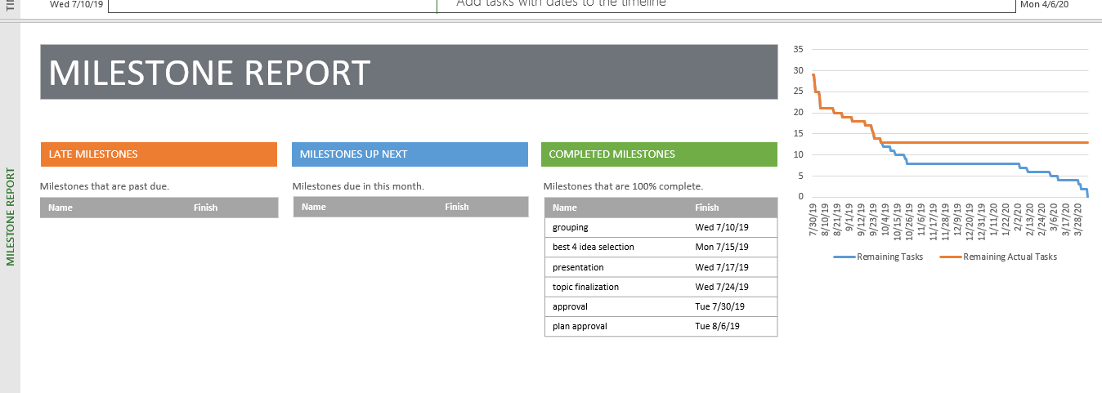
MILESTONE

Slide 15
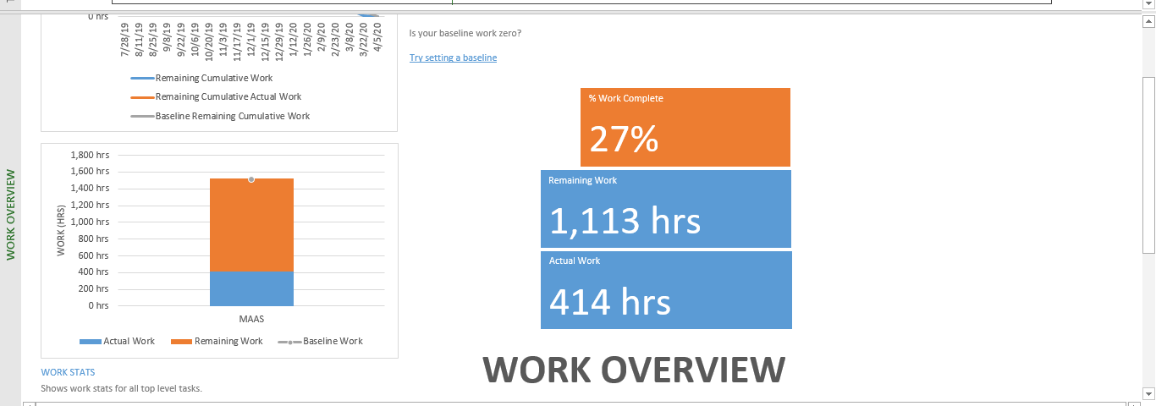
WORK ANAYLSIS

Slide 16
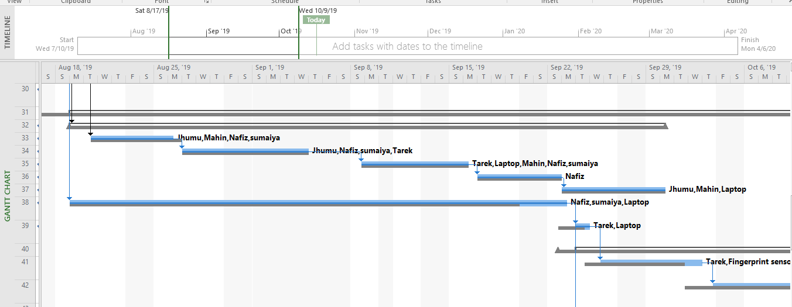
GRANTT CHART

Slide 17
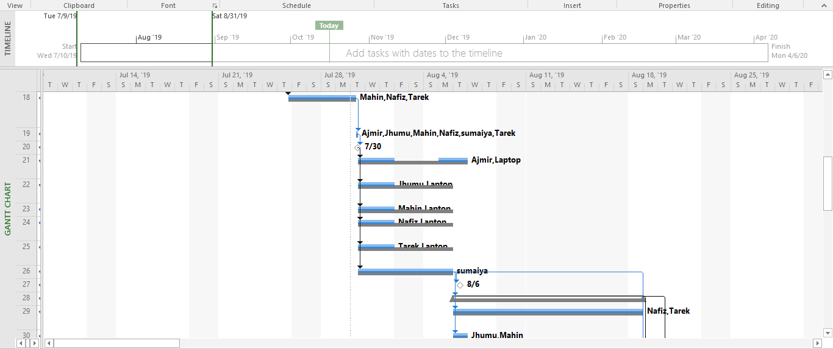
GRANTT CHART

Slide 18
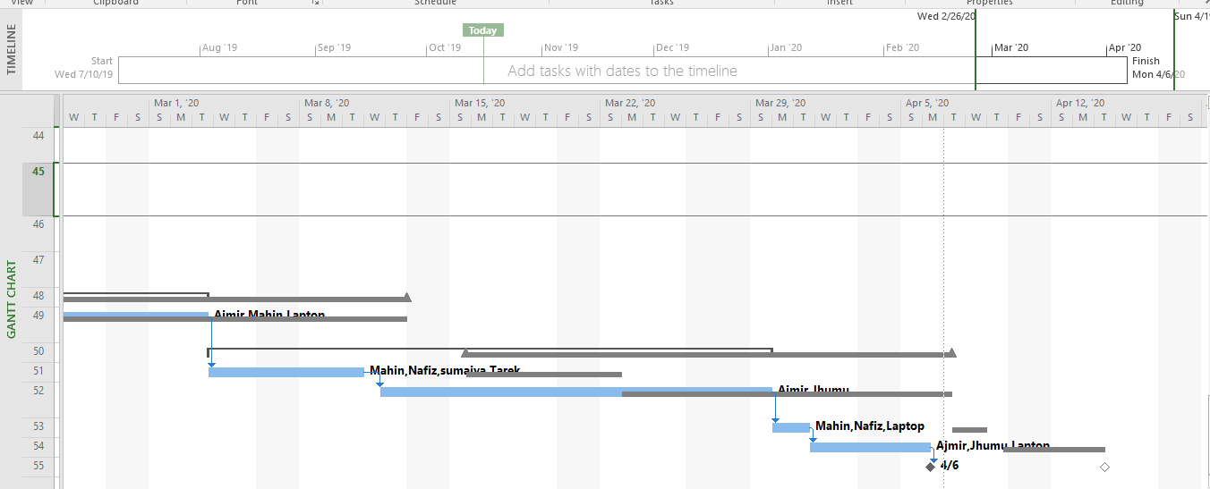
GRANTT CHART

Slide 19
STAKEHOLDERS

Slide 20
STAKEHOLDERS
Type of Stakeholder | Stakeholder Categories | Stakeholder Roles and Descriptions
INTERNAL | Course Instructors | Most important stakeholders. Engaged in dispersing all the necessary knowledge and providing all sorts of guidance.
 | System Developing Group | This is us. Engaged in design , implementation , testing and other activities related to the development of this system

Slide 21
STAKEHOLDERS
Type of Stakeholder | Stakeholder Categories | Stakeholder Roles and Descriptions
INTERNAL | MIST Authority | Provides all types of administrative support. For example: Providing fund for the project
EXTERNAL | Admin Staffs | Admin Staffs will control the admin panel of the system.Admin panel can be said the main Controller of the System.We can collect continuous feedback from them

Slide 22
STAKEHOLDERS
Type of Stakeholder | Stakeholder Categories | Stakeholder Roles and Descriptions
EXTERNAL | Students | It is being made for them. They can provide necessary feedbacks related to our system after use.
 | Teachers | Teacher will use the system for giving attendance.After implementation we can collect feedback from them.

Slide 23
SYSTEM ARCHITECTURE

Slide 24
SYSTEM ARCHITECTURE
Web Browser
Login Administrator Attendance System Application System Faculty Students Eligibility (Collegiate Non-collegiate ) Management Fine Management

Slide 25
SYSTEM ARCHITECTURE
Scanning Fingerprints Automatic Attendance Update LDR Scanning Applications And Fine Manager
Fingerprint Scanner Database LDR sensor

Slide 26
SYSTEM REQIUREMENT SPECIFICATION

Slide 27
USER REQUIREMENTS
Serial | User Requirements | Types of Requirement
 |  | Functional | Non- Functional
01. | Attendance taking using fingerprint sensor.
02. | Presented students at class will be tracked

Slide 28
USER REQUIREMENTS
Serial | User Requirements | Types of Requirement
 |  | Functional | Non- Functional
03. | All the information will be stored so it can be accessed anytime
04. | An application system for student to apply for their missed class is developed

Slide 29
SYSTEM REQUIREMENT
Serial | User Requirement | System Requirement
1 | Attendance taking using fingerprint sensor. | 1.1 Fingerprint sensor should be implemented outside the classroom
 |  | 1.2 Students should scan their finger before entering class
 |  | 1.3 A student can try scanning his finger 3 times at max
 |  | 1.4 Missing students information will be enrolled in database

Slide 30
SYSTEM REQUIREMENT
Serial | User Requirement | System Requirement
2 | Presented students at class will be tracked | 2.1 Before going out, a student must scan his finger
 |  | 2.2 LDR sensor will be used to detect students exiting class without scanning finger
 |  | 2.3 A certain amount of time for students will be provided for coming back at class
 |  | 2.4 Attendance will be removed if that student don’t come back at time

Slide 31
SYSTEM REQUIREMENT
Serial | User Requirement | System Requirement
3 | All the information will be stored so it can be accessed anytime | 3.1 Data of attendance of students will be stored at Firebase
 |  | 3.2 Data will be analyzed to create eligible students list for teachers and fine for students
 |  | 3.3 For yearly or any kind of analysis the stored data will be used
 |  | 3.4 Anyone has permission can access it anytime and only admin section has the authority to change anything.

Slide 32
SYSTEM REQUIREMENT
Serial | User Requirement | System Requirement
4 | An application system for student to apply for their missed class is developed | 4.1 Students has to provide valid reason
 |  | 4.2 Signed document should be provided with the application
 |  | 4.3 Teacher will approve the application if teacher find it valid
 |  | 4.4 Attendance will be updated if applications are accepted

Slide 33
GRAPHICAL REPRESNTATIONS

Slide 34
CONTEXT DIAGRAM

Slide 35
STATE DIAGRAM

Slide 36
USE CASE (SCENARIO-1)

Slide 37

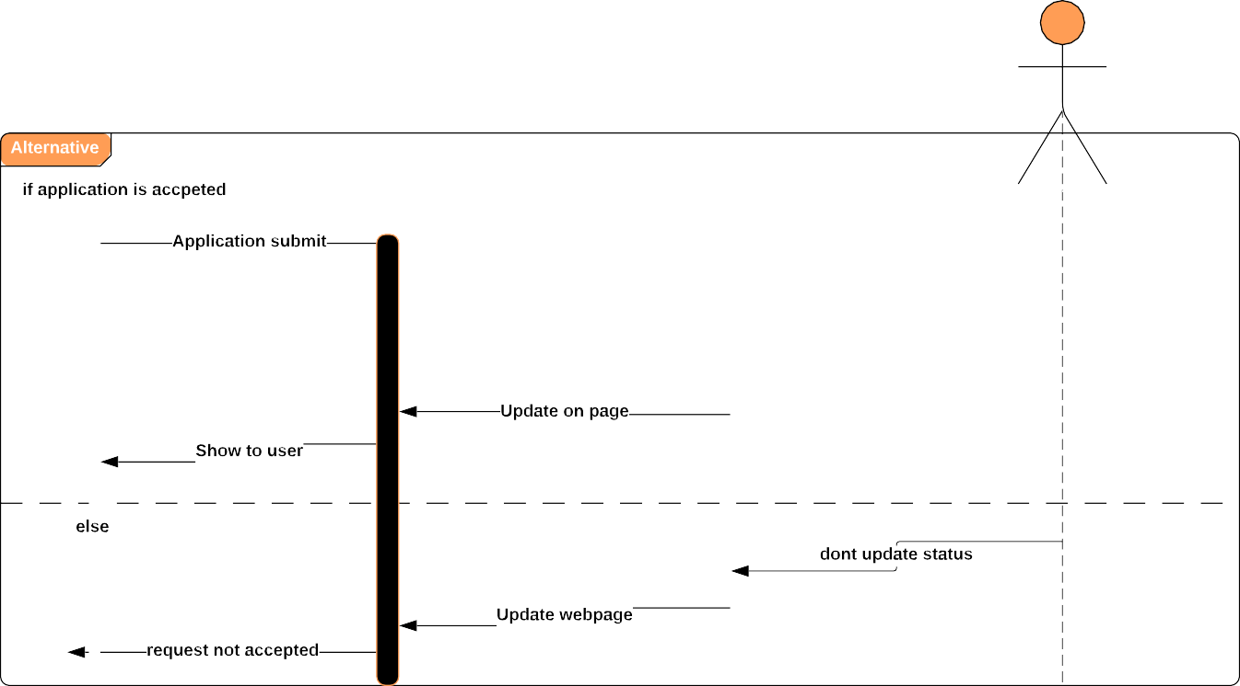
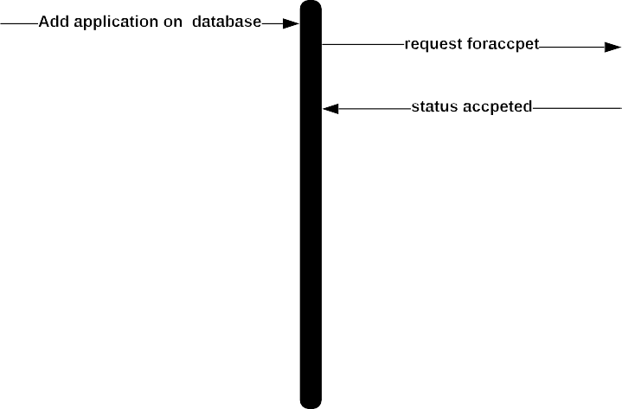
USECASE (SCENARIO-2)

Slide 38
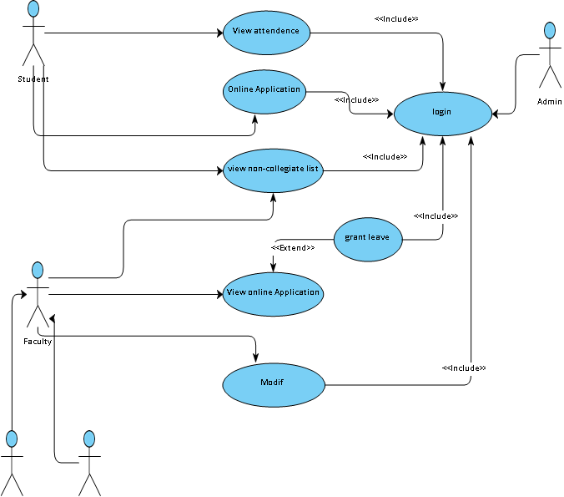
SEQUENCE DIAGRAM

Slide 39
DEMONSTRATION

Slide 40
QUESTION AND ANSWER SESSION

Slide 41
THANKS!

